Slide 1
1.1 Klasa i Obiekt

Slide 2
Klasa (11.4)

Slide 3
Klasa – szablon dla obiektów; definiuje atrybuty (attributes, properties) oraz operacje (operations, methods) które posiadają obiekty danej klasy.
No keyword is needed to indicate that the metaclass is Class
Class is a kind of EncapsulatedClassifier whose Features are Properties, Operations, Receptions, Ports and Connectors.
Attributes of a Class are Properties that are owned by the Class.

Slide 4
Semantyka 11.4.5
Class is a kind of EncapsulatedClassifier whose Features are Properties, Operations, Receptions, Ports and Connectors. Attributes of a Class are Properties that are owned by the Class. Some of these attributes may represent the ends of binary Associations.
When an object is instantiated in a Class, for every attribute of the Class that has a specified default, if an initial value of the attribute is not specified explicitly for the instantiation, then the default ValueSpecification is evaluated to set the initial value of the attribute for the object.
Operations of a Class can be invoked on an object, given a particular set of values for the parameters of the Operation, according to the semantics specified in 9.6.3.
A Class cannot access private Features of another Class, or protected Features on another Class that is not its ancestor.

Slide 5
Notacja (11.4.4)
Reprezentowany przez symbol Classifier
Four mandatory compartments:
Attributes
Operations
Receptions
Internal sctructure
Optional compartments according to Classifiers in general (9.2.4)

Slide 6
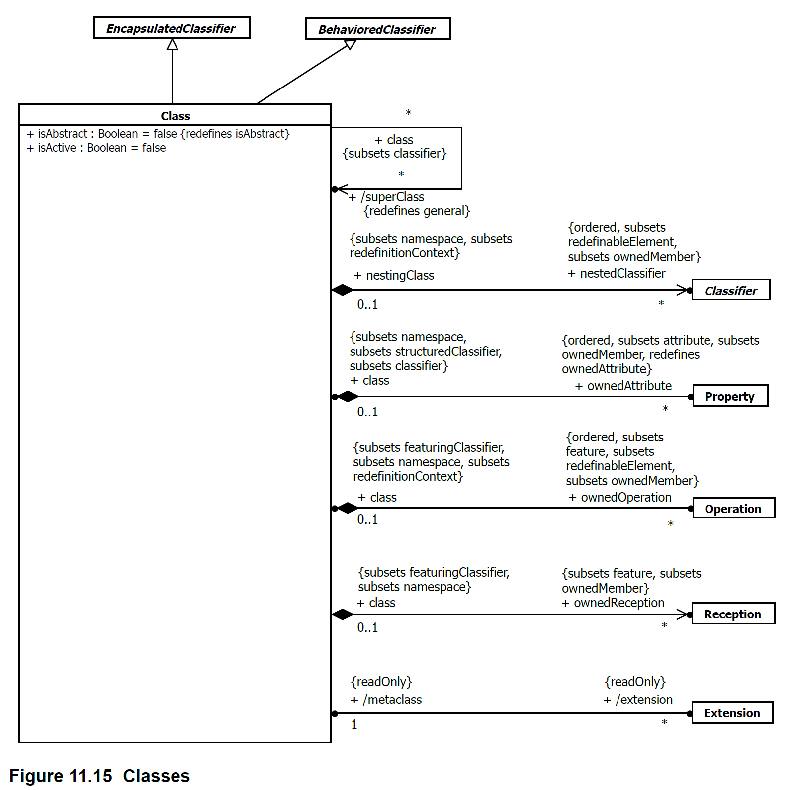

Slide 7
Obiekt (11.4)

Slide 8
Obiekt – instancja klasy ☺

Slide 9
